Slide 1
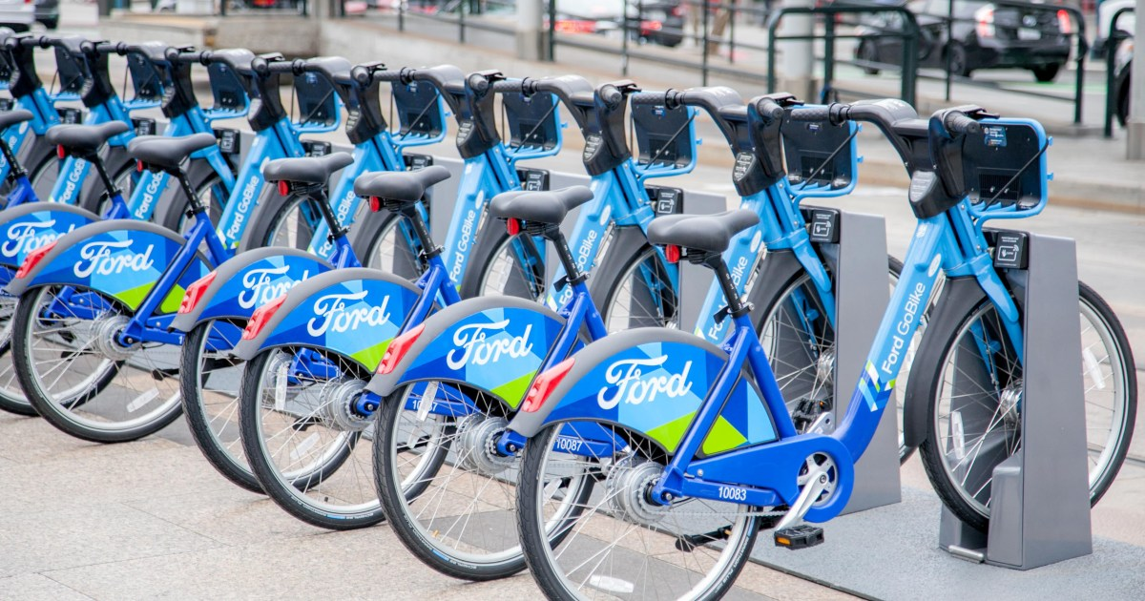
Ford Bike Sharing Project: An Exploratory Analysis of Features Affecting Trip Duration
Labmentix Internship Project : Capstone EDA Submission
By Shrijay Talap

Slide 2
Table of Contents
Introduction of the Topic and Dataset
Dataset Investigation and Data Wrangling Pipeline
Univariate Data Exploration
Bivariate Analysis: Commuters vs. Leisure Patterns
Multivariate Exploration & Feature Correlations
Strategic Business Solutions & Conclusions

Slide 3
Project Context & Motivation
As urban areas turn to micro-mobility to beat gridlock, managing bike-share networks efficiently becomes a major challenge. Without clear insights into how people ride, system fleets face severe supply imbalances—running out of bikes or empty docks during morning and evening rush hours, while inventory sits completely idle during off-peak windows. This analysis dives deep into real transactional logs to uncover operational gaps, streamline bike rebalancing schedules, and find untapped user segments to drive platform revenue.

Slide 4
Dataset Overview & Objectives
Project Scope:
Consolidated and analysed a multi-file transactional system dataset tracking trip durations, geographic coordinates, station profiles, and user demographics.
Built data cleaning pipelines to isolate missing values and map coordinates.
Core Analytical Focus:
Optimize Operations: Map precise hourly peak windows to help ground crews build smart fleet rebalancing schedules.
Drive User Conversion: Pinpoint differences between casual Customers and annual Subscribers to design high-impact marketing funnels.

Slide 5
Core Findings: What Drives Trip Duration?
The Subscriber Engine: Annual subscribers make up 85–90% of all platform traffic. Their rides are routine, highly efficient, and tightly clustered around standard weekday commute windows (8 AM and 5 PM) with short average trip lengths (10–15 mins).
The Casual Growth Opportunity: Short-term, non-subscribing customers display a smooth, bell-shaped midday active curve. While their total trip volume is lower, their average ride duration surges by roughly 60% on weekends, heavily driving leisure and tourist travel metrics.
Target Demographics: System usage peaks intensely among young professionals aged 25–38 and skews heavily male (over 70%), highlighting an incredible opportunity to run targeted expansion campaigns aimed at increasing adoption among female and senior riders.

Slide 6
Data Wrangling & Pipeline
From multi-file raw CSV fragmentation to a unified, clean, feature-engineered database.

Slide 7
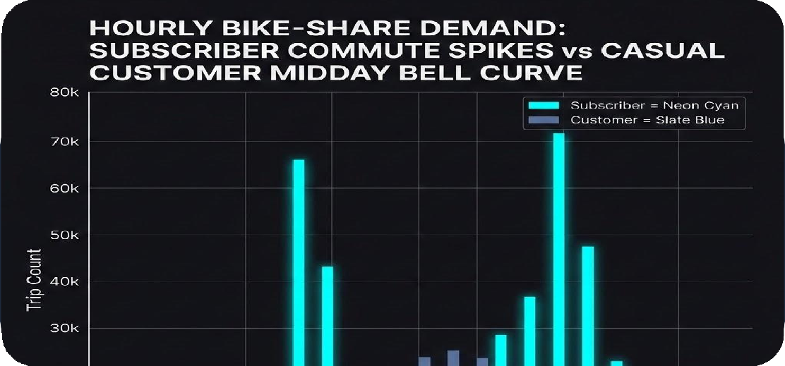
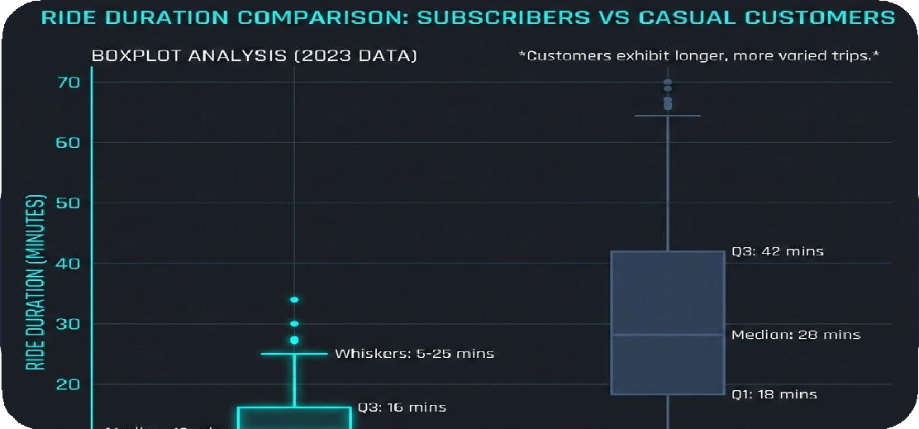
User Segmentation & Behavioral Variances
Subscriber Commuter Footprint
Rigid Peak Patterns: Subscribers make up 85–90% of total volume, maintaining strict utility behaviors tied to morning and evening rush-hour intervals.
High-Efficiency Rides: Average ride times are tightly clustered around 10–15 minutes, proving their use is strictly destination-focused.
Casual Customer Growth Footprint
Midday Leisure Trajectory: Casual riders exhibit a smooth, bell-shaped midday active curve that drops the dual rush-hour commute spikes.
60% Duration Expansion: Total trip length surges significantly on weekends, indicating deep engagement with leisure travel, tourism, and open-ended exploration.

Slide 8
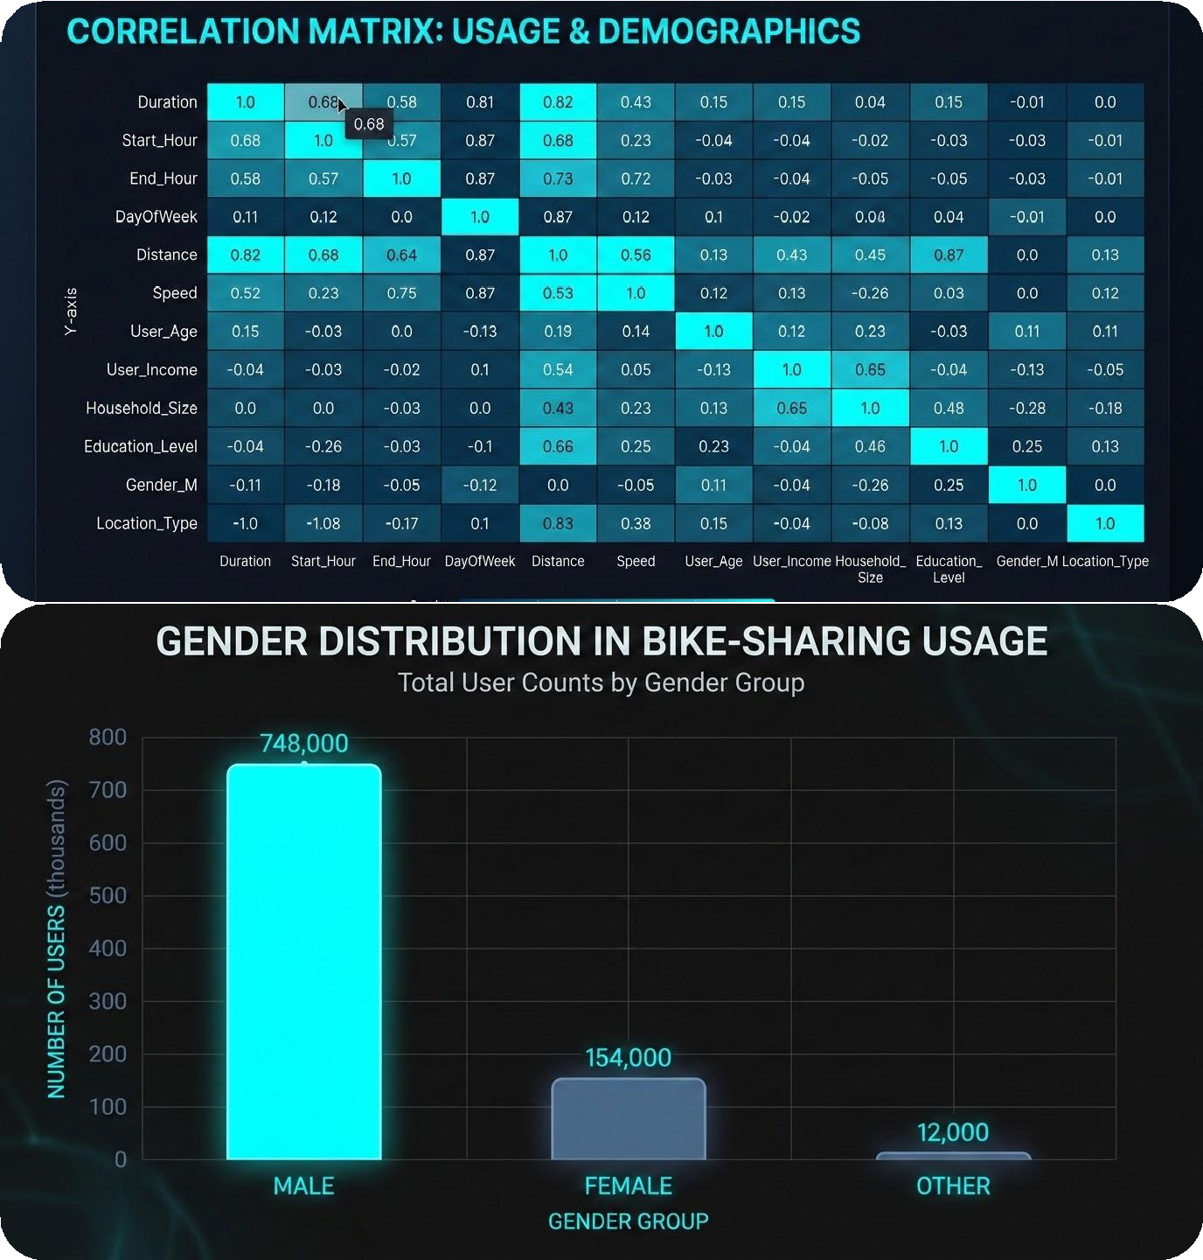
Demographic Constraints & Feature Associations
Demographic Constraints & Associations
The Core Consumer Profile: Platform adoption highlights an intense concentration among young professionals and students aged 25–38.
Severe Gender Imbalance: Male riders generate over 70% of total system transactions, indicating a major underrepresented segment in other demographic buckets.
Statistical Independence: The correlation matrix confirms that engineered time parameters (hours, calendar months) show near-zero linear correlations with ride duration, proving trip length is driven by user intent rather than environmental schedules.

Slide 9
Data Processing & Engineering Architecture
Multi-File Integration Pipeline
The Fragmentation Challenge: Raw mobility transactional records were heavily distributed across independent, monthly/seasonal CSV sheets.
Automated Consolidation: Developed a programmatic pipeline using Python's glob and os modules to dynamically sweep target paths.
High-Performance Merge: Executed optimized row-wise concatenation via pd.concat to seamlessly stitch files into a unified master frame.
Wrangling & Feature Engineering
Missing Data Mitigation: Used missing value heatmaps to isolate structural gaps, cleanly dropping records lacking vital location names.
Temporal Casting: Transformed raw string objects into standard datetime structures (datetime64[ns]) for precise chronological tracking.
Feature Extraction: Extracted new fields including start_hour, day_of_week, and month, and converted durations into human-readable minutes.

Slide 10
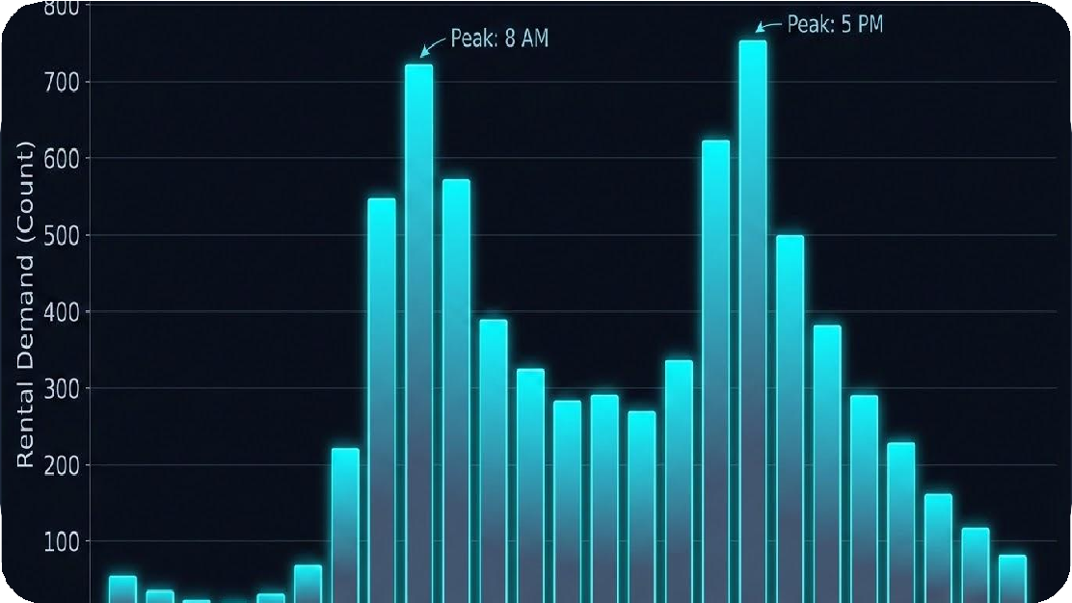
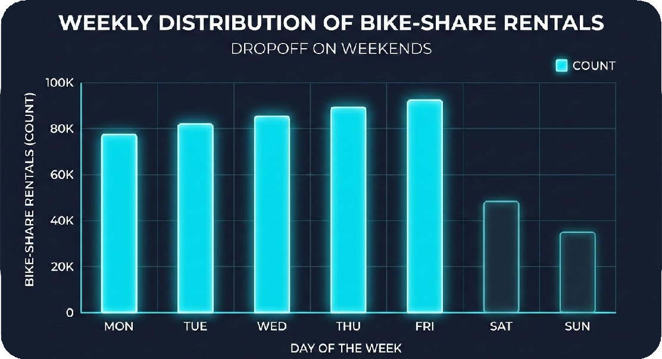
Profiling Bike-Share Demand Timelines
Key Analytical Observations
Bimodal Peak Commute Cycles: The system exhibits prominent, sharp spikes precisely between 8:00 AM – 9:00 AM and 5:00 PM – 6:00 PM, strictly tracking white-collar business and university transit windows.
Midday Plateau Dynamics: Demand transitions into a steady, lower-volume plateau between 10:00 AM and 4:00 PM, indicating secondary baseline utility tracking.
Weekend Traffic Dip: Total aggregate trip counts fall off noticeably on Saturdays and Sundays, proving routine professional commuting provides the platform's baseline workload.

Slide 11




Strategic Business Solutions & Conclusions
Smart Fleet Rebalancing
Direct ground crews to run rebalancing operations during off-peak midday windows (10 AM - 2 PM), moving idle residential units to business sectors before the evening rush.
Weekend Asset Monetization
Introduce targeted "Weekend Explorer" bundles and partnership perks with parks/cafes to capture high-duration casual tourist demand and monetize weekend inventory.
Demographics Expansion
Launch inclusion campaigns highlighting safety and protected infrastructure routes to target underrepresented demographics, closing the 70% male variance.
Final Core Conclusion
Balancing commuter weekday reliability with weekend leisure packages maximizes vehicle lifetime value, stabilizes revenue streams, and scales platform growth.

